Slide 1

Navsahyadri Group of Institutes Faculty of Engineering, PUNE
Department of Computer Engineering
Department of Artificial Intelligence & Machine Learning Engineering
Academic Year: 2023-24
Presentation on:- INTERNSHIP PROJECT
GUIDED BY :
Prof.PUNAM SHINDE
NESGI,Pune.
PRESENTED BY :
AMOGSIDDHA BURHANPURE

Slide 2

Presentation Content-
Introduction of Company
Internship Technology
Problem Statement
Project Objective
Methodological Details
Project Output/Result
Conclusion
Certificate of Internship

Slide 3

Introduction of Company -
Name of Company / Organization: - N Infinity Info Solutions
Details about Company / Organization: -
Is an IT specialized firm which works in following segments:
-IT Software Development and IT Services
- IT Training and Research
- Live Project Working Experience
Address: -
2 Floor, Sarawati Boys Hostel,
Opposite Sinhgad Law College Sinhgad College,
Vadgaon – Ambegaon Campus. Pune-46
External Supervisor Name: -
Mr. Prasad Sase,
Mr. Rushikesh Gondake
Contact number: - 9422020202, 9766088279
Email ID: - info@ninfinitysolutions.com

Slide 4

Introduction
Java Development Internship
Welcome to the project review presentation on “ Building an Interactive Dashboard with Streamlit.” Today, we'll delve into the journey of creating a user-friendly platform for data visualization and exploration.
Introduction to the importance of interactive dashboards in enabling users to derive insights, make informed decisions, and drive innovation in various domains.

Slide 5

Problem Statement
Delve into the challenges faced by data analysts and researchers in creating interactive dashboards, including the complexity of traditional methods and the steep learning curves associated with coding.
Highlight the pressing need for intuitive and accessible solutions that empower users of all backgrounds to explore and visualize data effortlessly.

Slide 6
Motivation
Explore the motivations behind choosing this project, including the growing demand for user-friendly data visualization tools and the transformative potential of Streamlit, Pandas, and Plotly in democratizing data analysis.
Discuss the significance of accessible and intuitive tools in fostering a culture of data-driven decision-making and innovation across diverse domains.

Slide 7
Methodological Details
Data collection and preprocessing: Acquiring and preparing a sample dataset suitable for demonstration purposes.
Dashboard design and layout: Crafting an intuitive and responsive user interface using Streamlit's declarative syntax.
Visualization creation with Plotly: Leveraging Plotly's rich library of graphing components to create interactive visualizations.
Integration with Pandas for data manipulation: Seamless incorporation of Pandas for efficient data processing and analysis within the dashboard environment.
Deployment and hosting: Deploying the dashboard to a hosting platform for public access, ensuring compatibility across devices.

Slide 8
Project Output/Result
Functionality: Showcase the diverse range of features and interactive elements offered by the dashboard, including dynamic data visualization and responsive user interface elements.
Usability: Share feedback from stakeholders and test users, highlighting their satisfaction with the dashboard's simplicity, responsiveness, and ease of navigation.
Impact: Discuss the potential applications and implications of the dashboard in facilitating data-driven decision-making and fostering a culture of data literacy and collaboration.

Slide 9
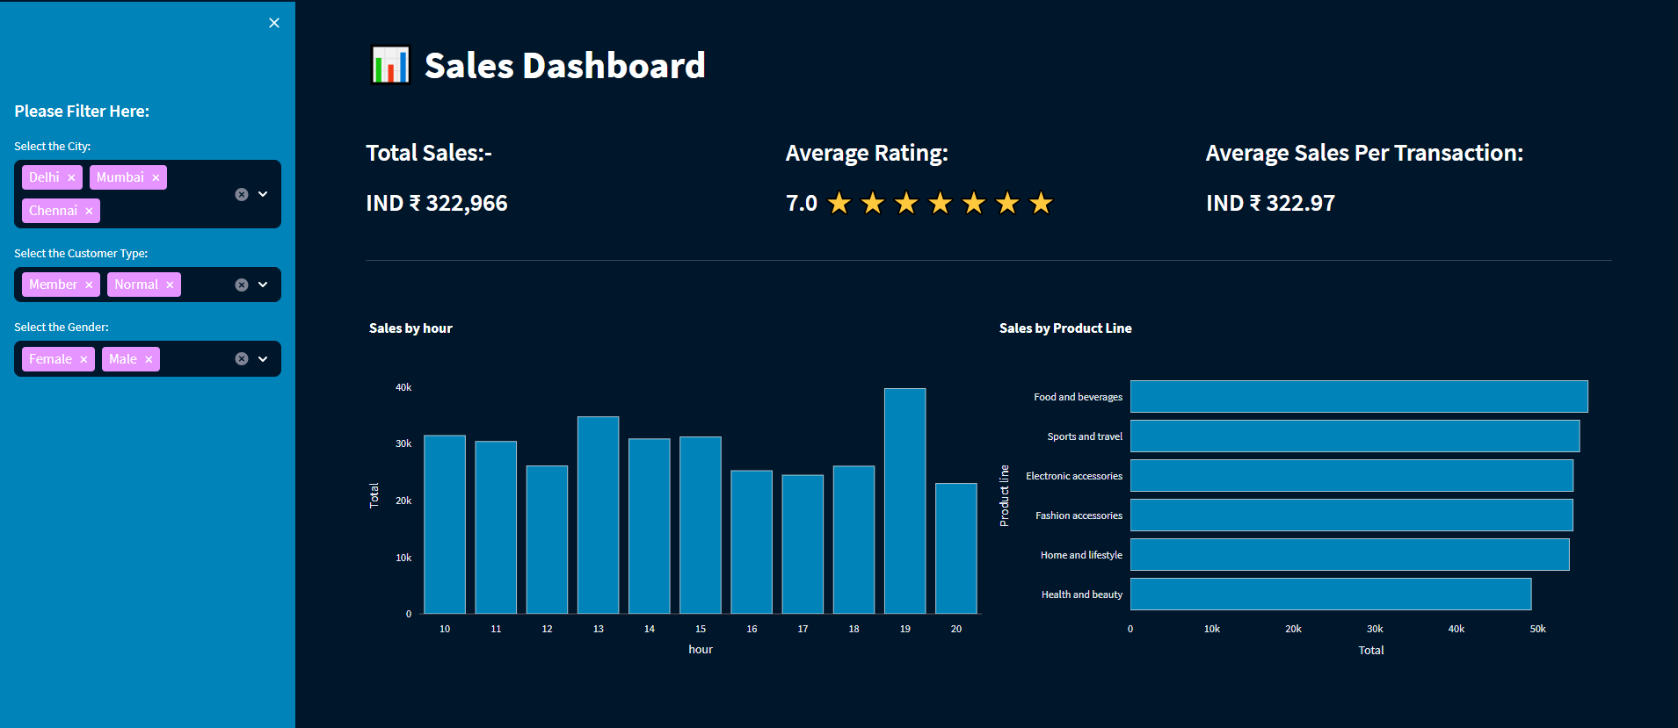
Project Output/Result
Interactive Dashboard

Slide 10

Conclusion -
In conclusion, the Interactive Excel Dashboard with Python using Streamlit Library project has been successfully developed, providing a user-friendly analysis interface.
Through this project, I have gained valuable experience in Python programming using Streamlit, Plotly, Pandas and data manipulation.
Overall, this project has provided a solid foundation in software development and Data Analysis, and I look forward to applying these skills to future projects and endeavors.

Slide 11
Thank You
For your Attention
GUIDED BY :
Prof. PUNAM SHINDE NESGI,Pune.
PRESENTED BY :
Amogsiddha Burhanpure

